Slide 1
Kochen-Specker Theorem in QIVPM

Slide 2
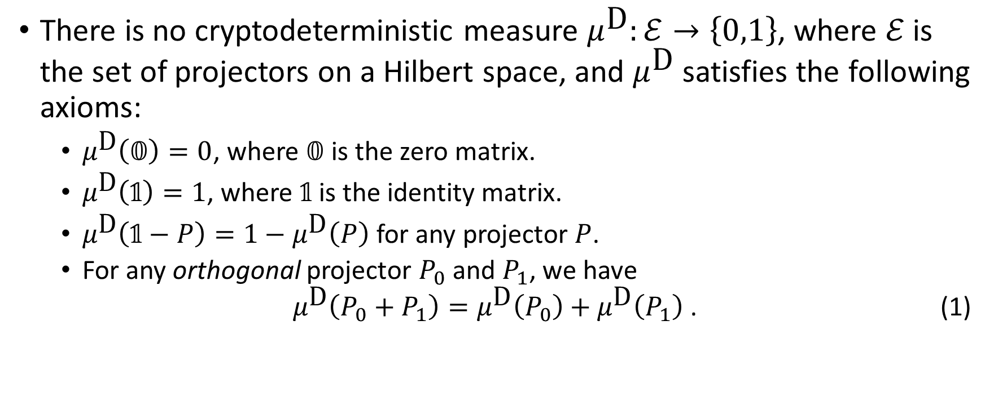
Kochen-Specker Theorem
There is no cryptodeterministic measure $μ^{\text{D}}:ℰ→\left\{0,1\right\}$, where $ℰ$ is the set of projectors on a Hilbert space, and $μ^{\text{D}}$ satisfies the following axioms:
$μ^{\text{D}}\left(𝟘\right)=0$, where $𝟘$ is the zero matrix.
$μ^{\text{D}}\left(𝟙\right)=1$, where $𝟙$ is the identity matrix.
$μ^{\text{D}}\left(𝟙−P\right)=1−μ^{\text{D}}\left(P\right)$ for any projector $P$.
For any orthogonal projector $P_{0}$ and $P_{1}$, we have $μ^{\text{D}}\left(P_{0}+P_{1}\right)=μ^{\text{D}}\left(P_{0}\right)+μ^{\text{D}}\left(P_{1}\right)$ . (1)

Slide 3
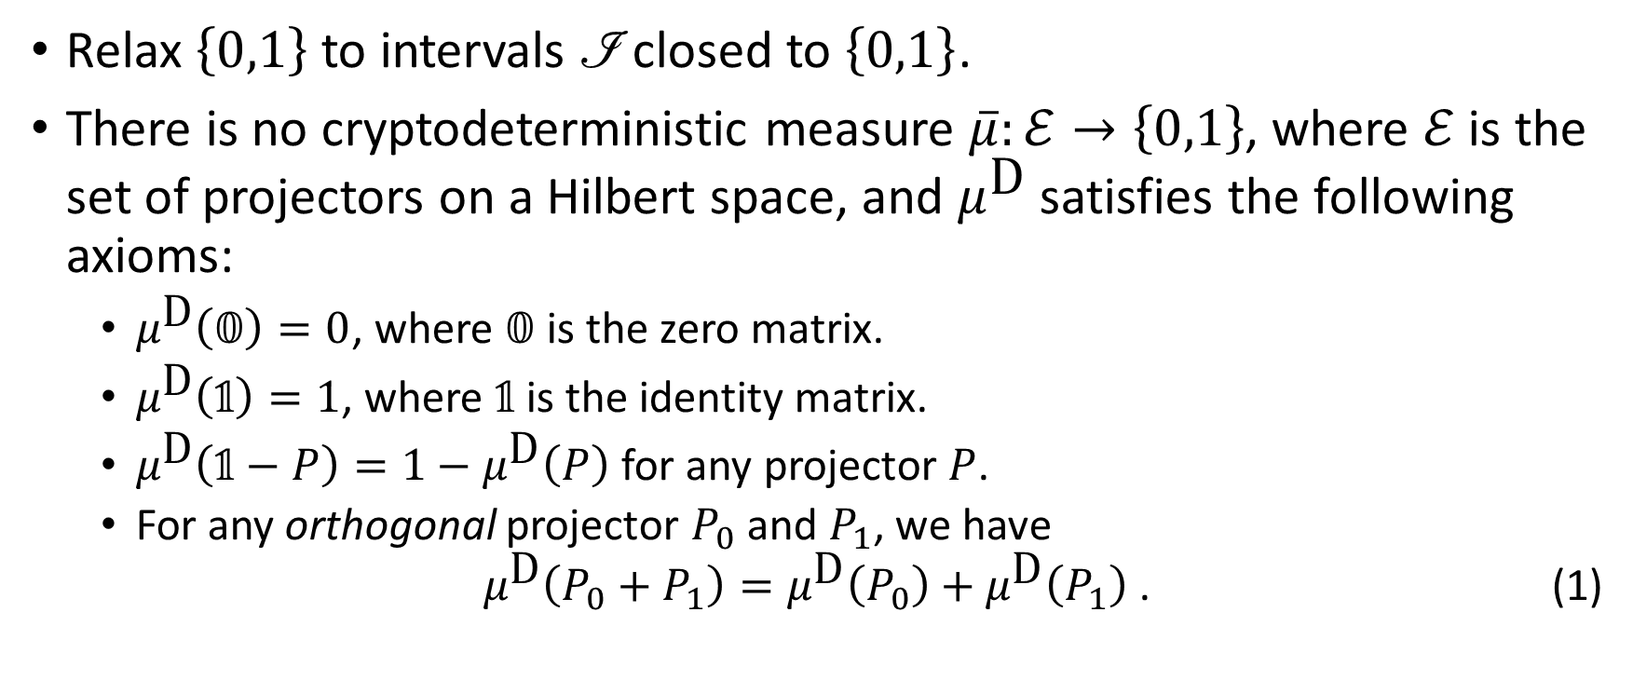
Finite Precision Measurement
Relax $\left\{0,1\right\}$ to intervals $\text{ℐ}$ closed to $\left\{0,1\right\}$.
There is no cryptodeterministic measure $\overline{μ}:ℰ→\left\{0,1\right\}$, where $ℰ$ is the set of projectors on a Hilbert space, and $μ^{\text{D}}$ satisfies the following axioms:
$μ^{\text{D}}\left(𝟘\right)=0$, where $𝟘$ is the zero matrix.
$μ^{\text{D}}\left(𝟙\right)=1$, where $𝟙$ is the identity matrix.
$μ^{\text{D}}\left(𝟙−P\right)=1−μ^{\text{D}}\left(P\right)$ for any projector $P$.
For any orthogonal projector $P_{0}$ and $P_{1}$, we have $μ^{\text{D}}\left(P_{0}+P_{1}\right)=μ^{\text{D}}\left(P_{0}\right)+μ^{\text{D}}\left(P_{1}\right)$ . (1)
Notes:
XITS font is required to display Formal Script (\mathscr) font correctly.
https://www.ctan.org/tex-archive/fonts/xits/

